Slide 1
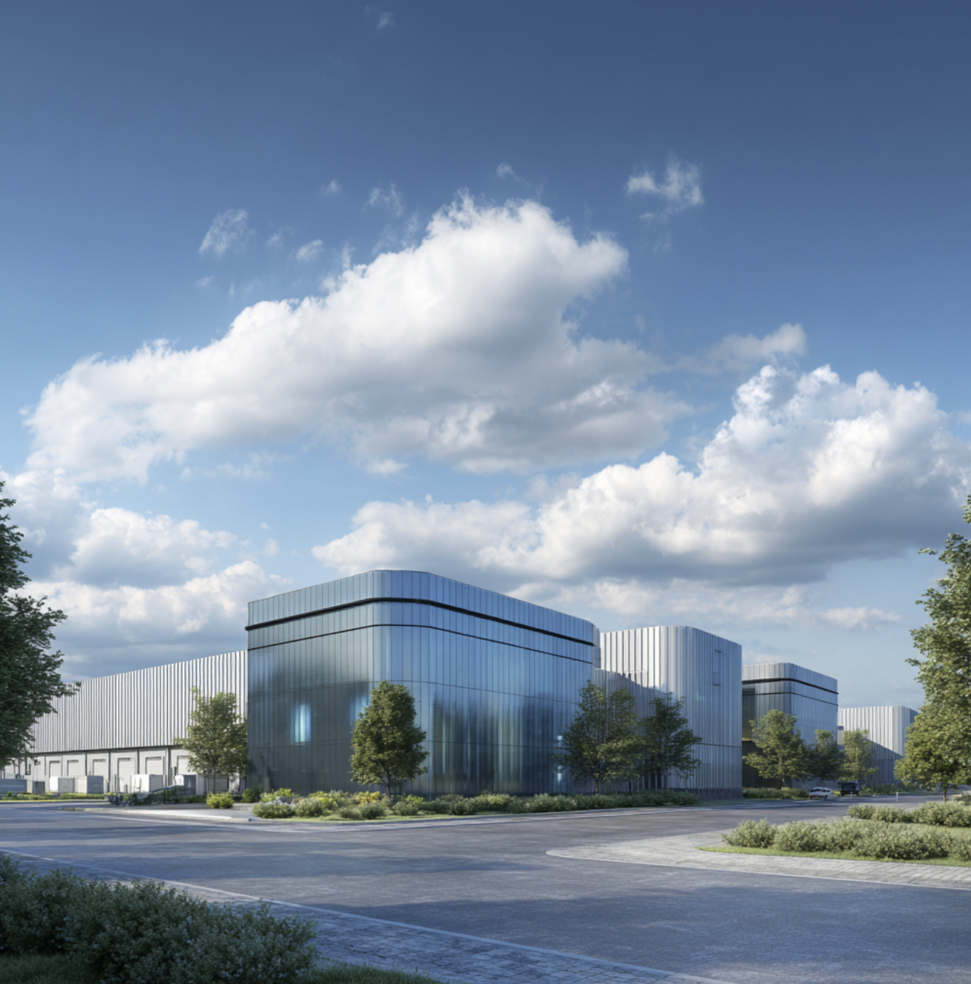
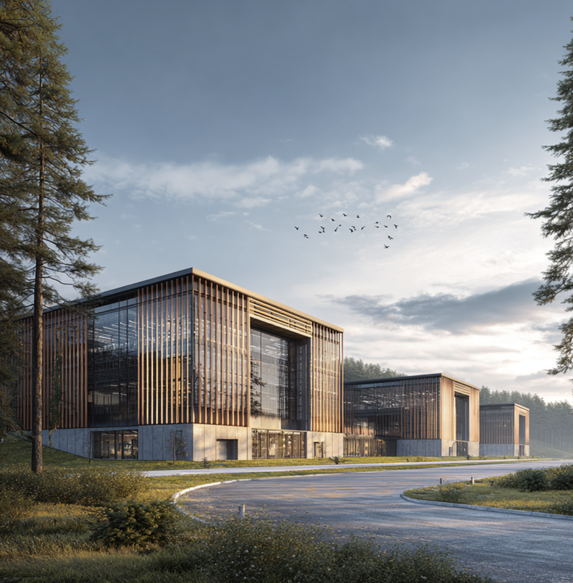
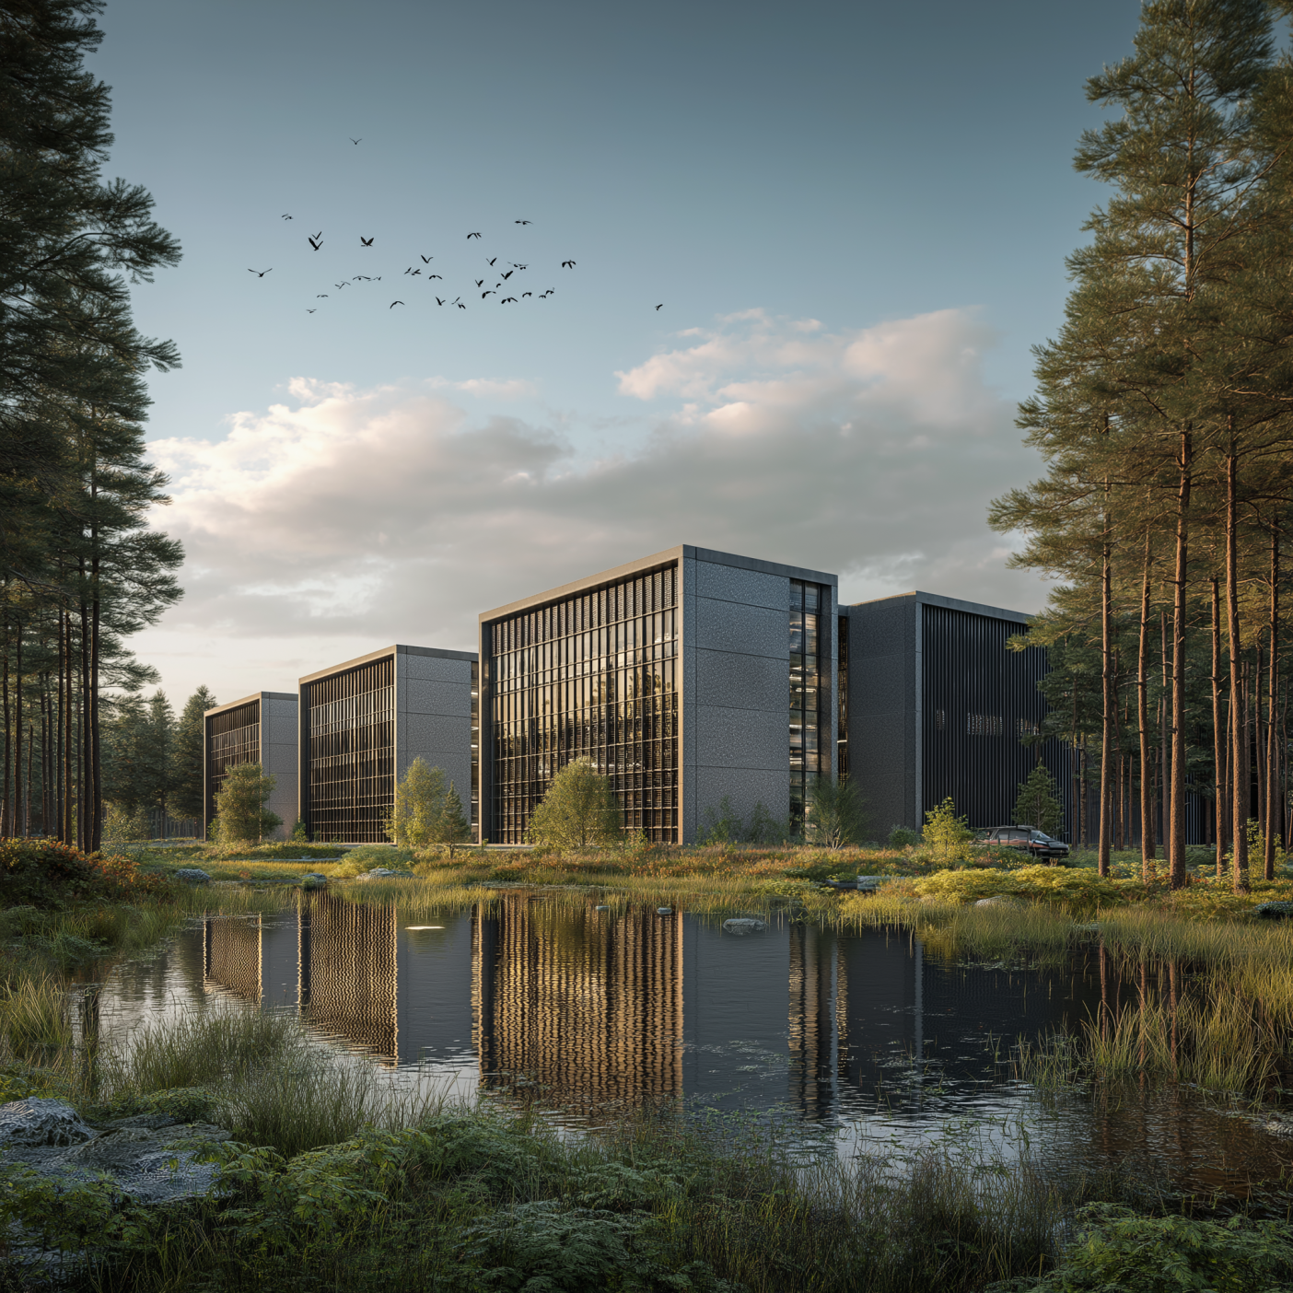

DC Opportunity
Sochaux
Confidential

Slide 2
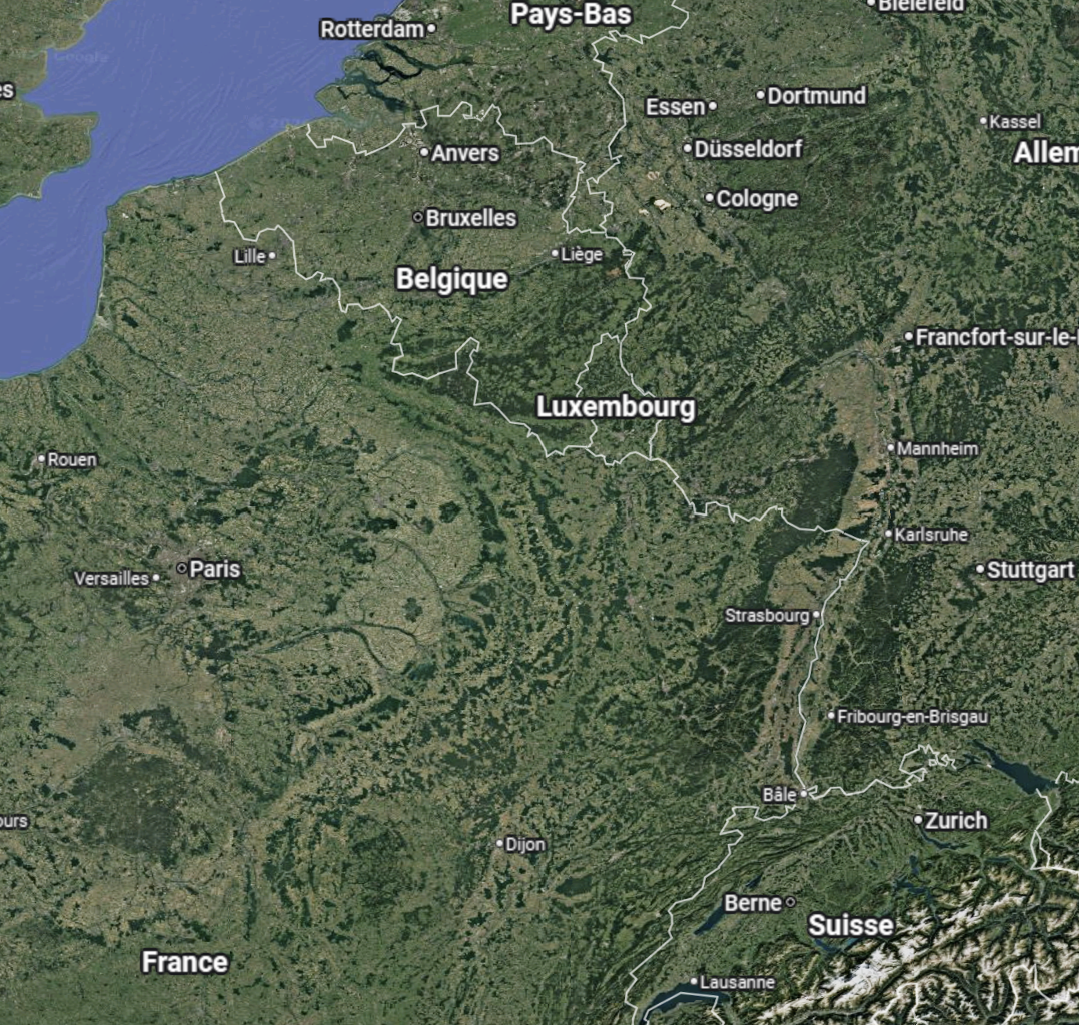

Location
Comments
Distance from Strasbourg: 120km Distance from Franfurt am Main: 320km Distance from Paris: 360km

Slide 3
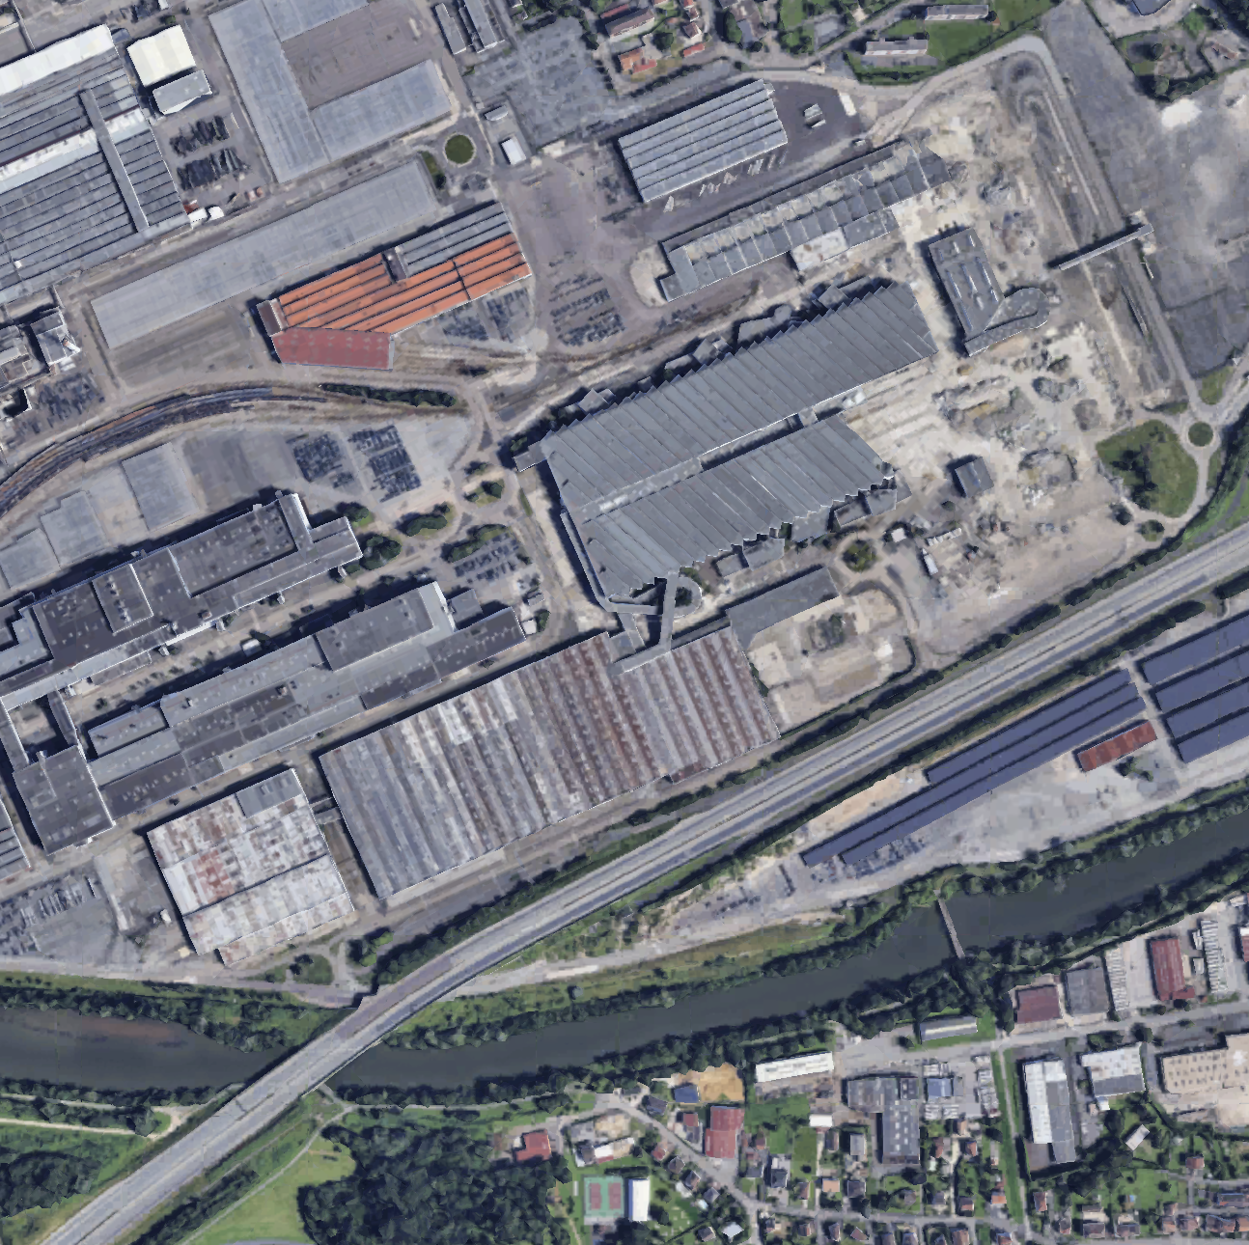
Landplot
Comments
Landplot: c. 35 ha

Slide 4
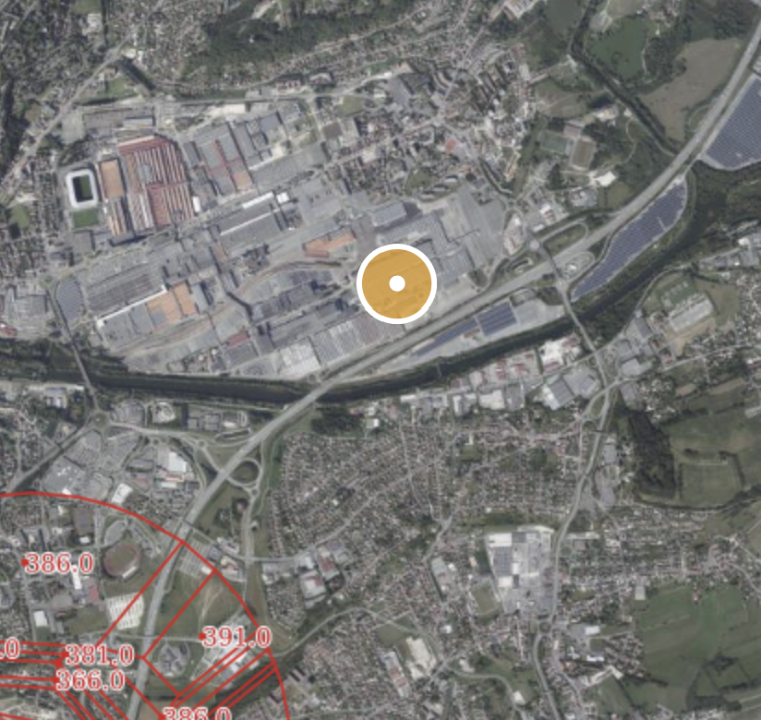
Airports
Comments
Landplot outside any aerodrome servitude
Pas de risque aérien

Slide 5
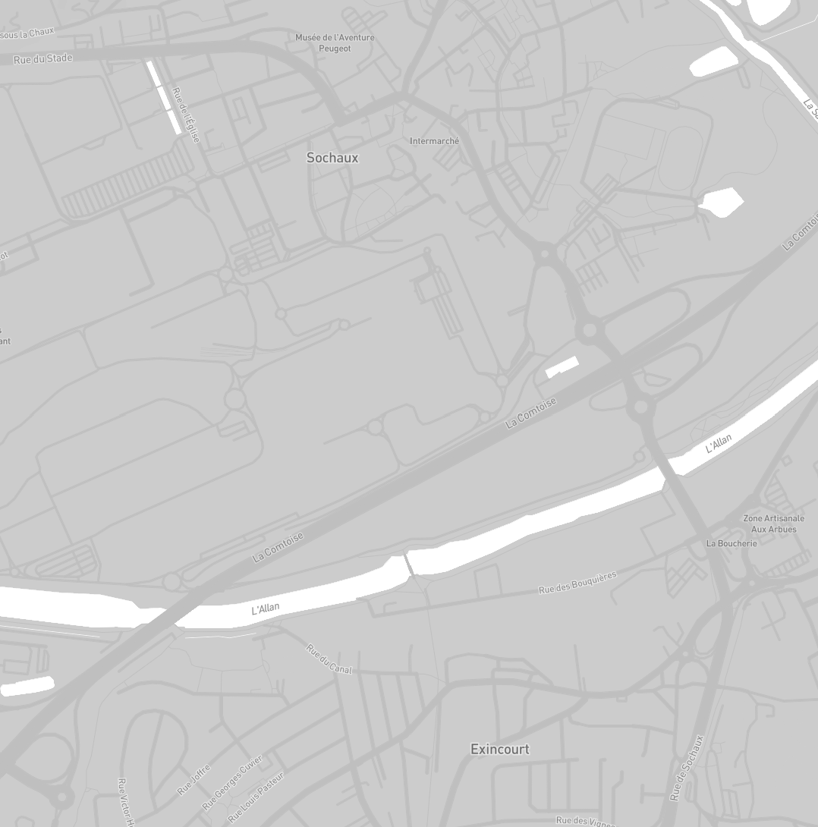
Connectivity
Comments
The site is very close to major fiber backbone (50m distance)

Slide 6
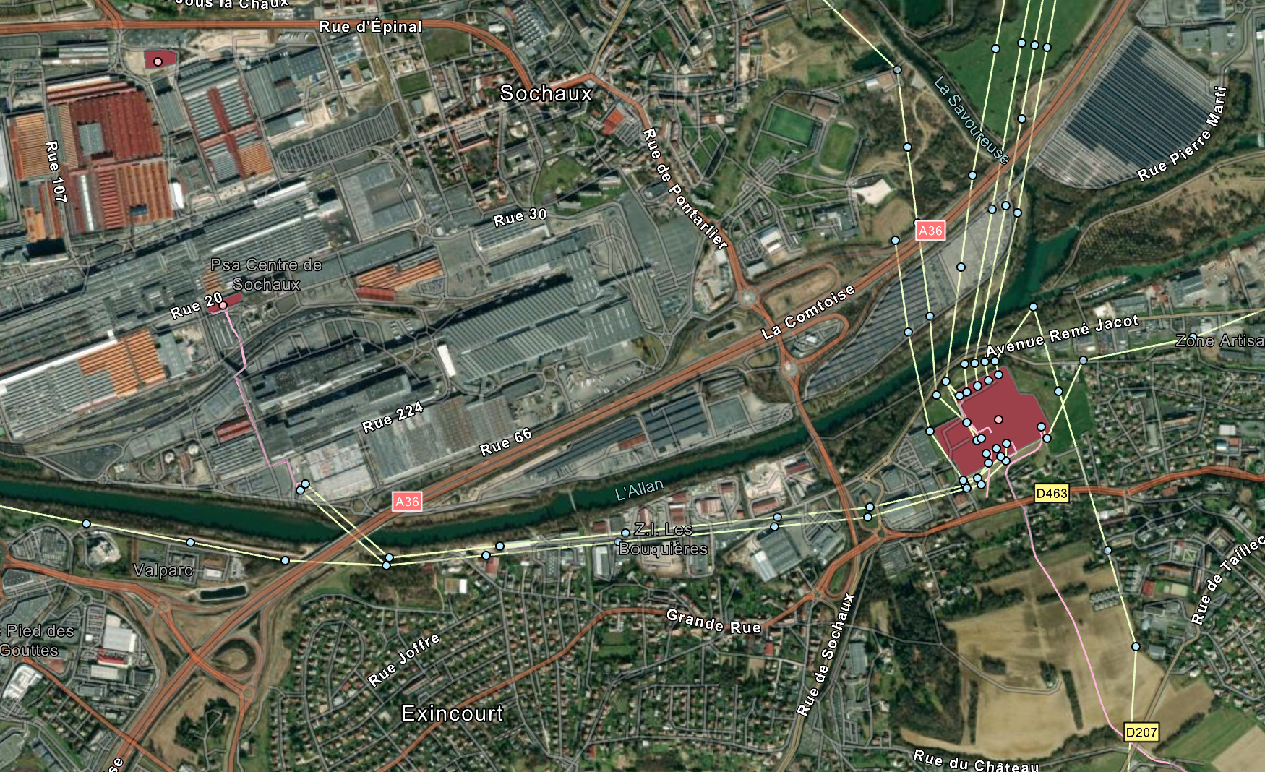
Power environment
Comments
The site offers diversified power connection options 1 – 63KV substation (450m distance) 2 – Études 225KV substation (1.9km distance)
1
2
3

Slide 7
Environmental Risks

Slide 8
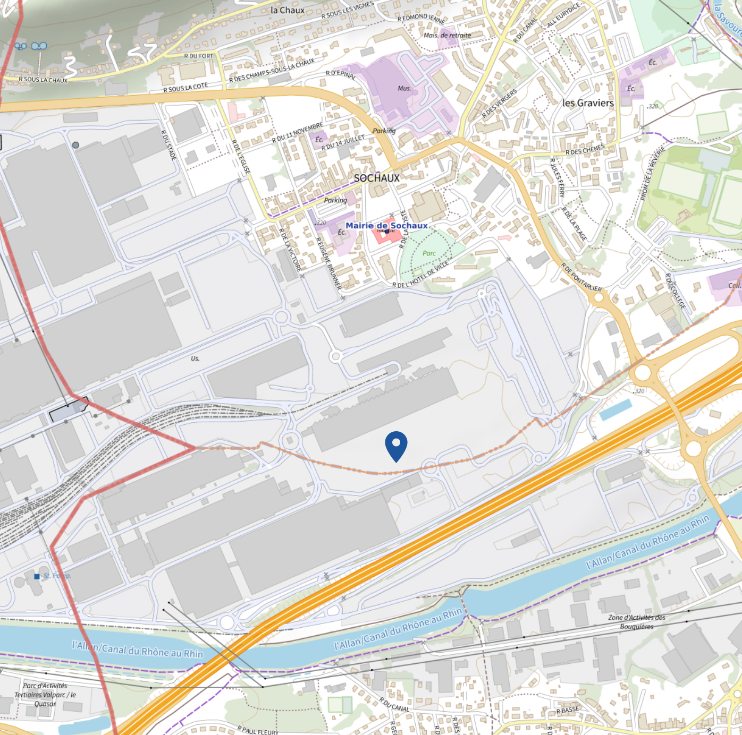
Technological & Chemical Risk
Comments
No SEVESO high sites within 1.5 km
*^*

Slide 9
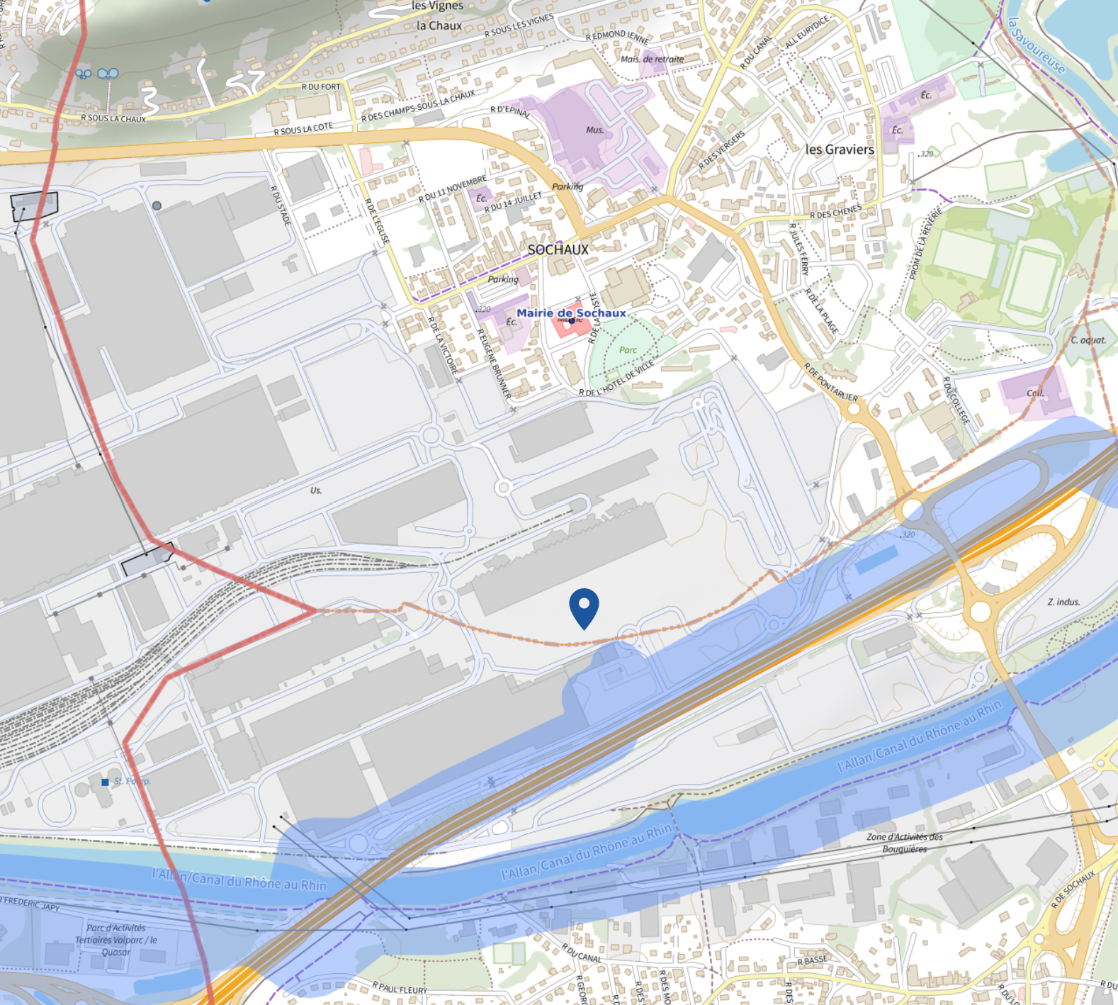
Technological Risks
Comments
Landplot impacted by hydrocarbon and gas pipeline

Slide 10
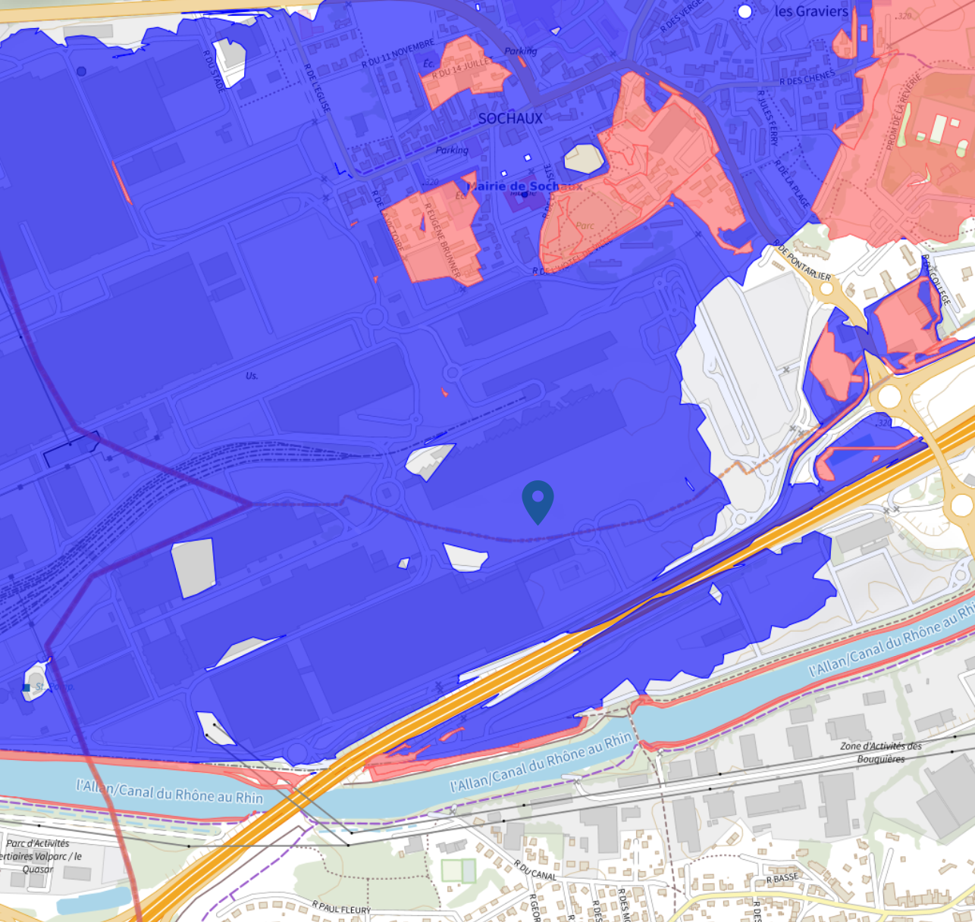
Flood risk
Comments
Landplot impacted by the flood area

Slide 11
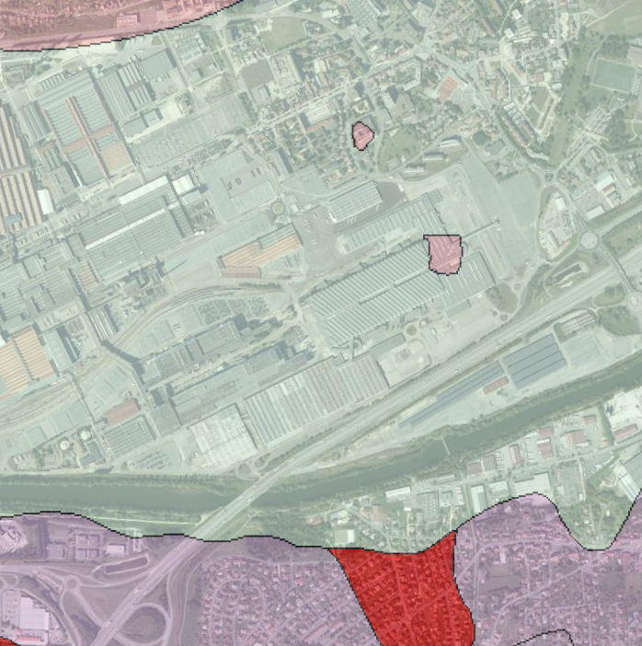
Soil
Comments
Marls containing Helix and Mytilus, sandstone, conglomerates and lacustrine limestones (Ludian) Recent undifferentiated alluvial deposits, gravel, sand and clay

Slide 12
Local urban development analysis (PLU)

Slide 13
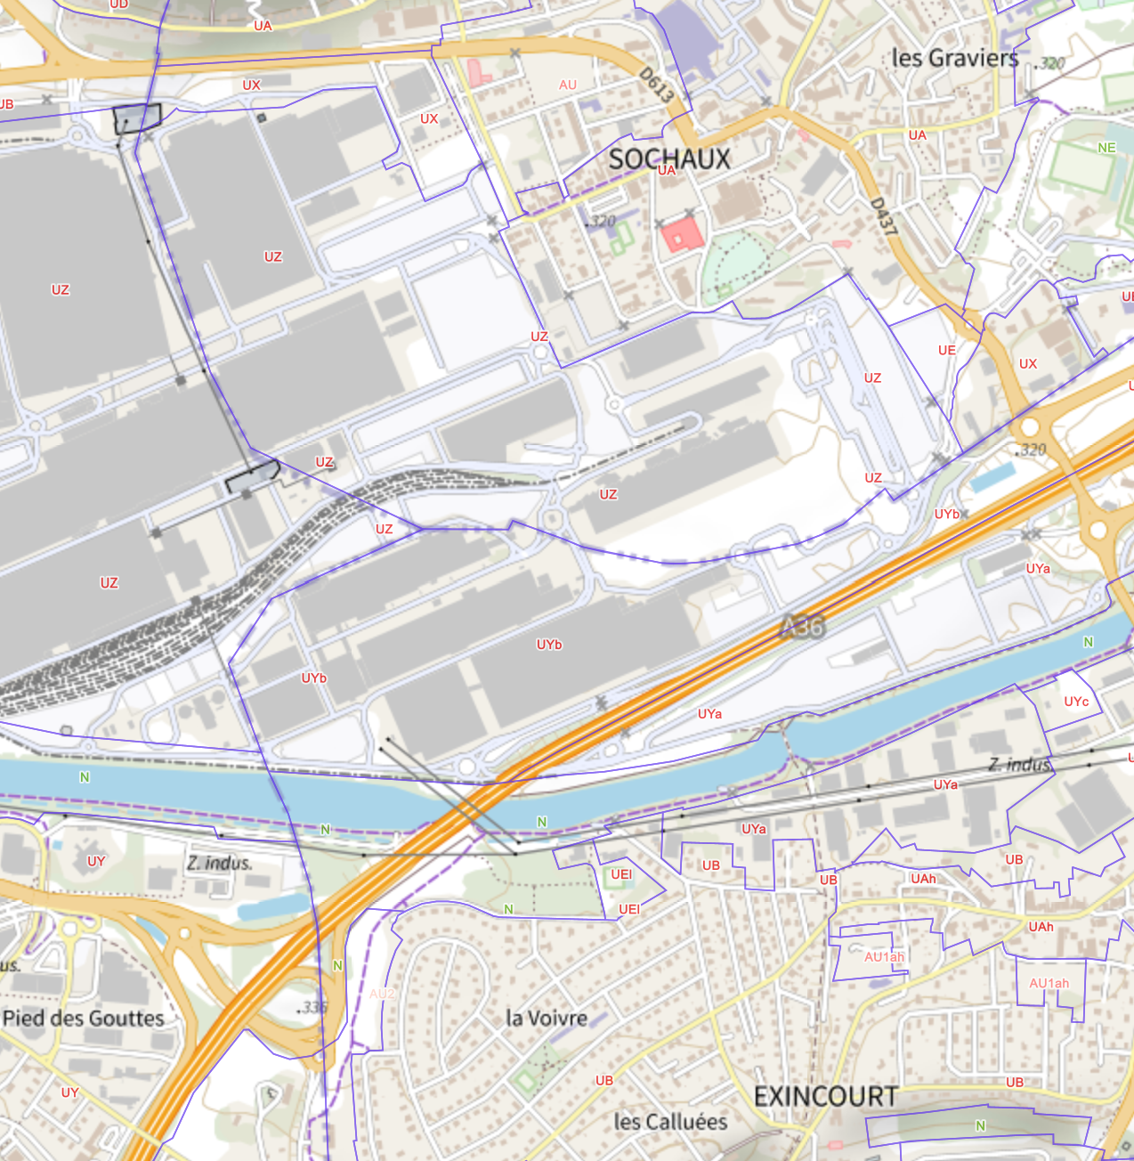
PLU analysis
Comments
Landplot located in UZ and UYb area UZ : Industrial estate UYb : Sites intended primarily for industrial activities

Slide 14
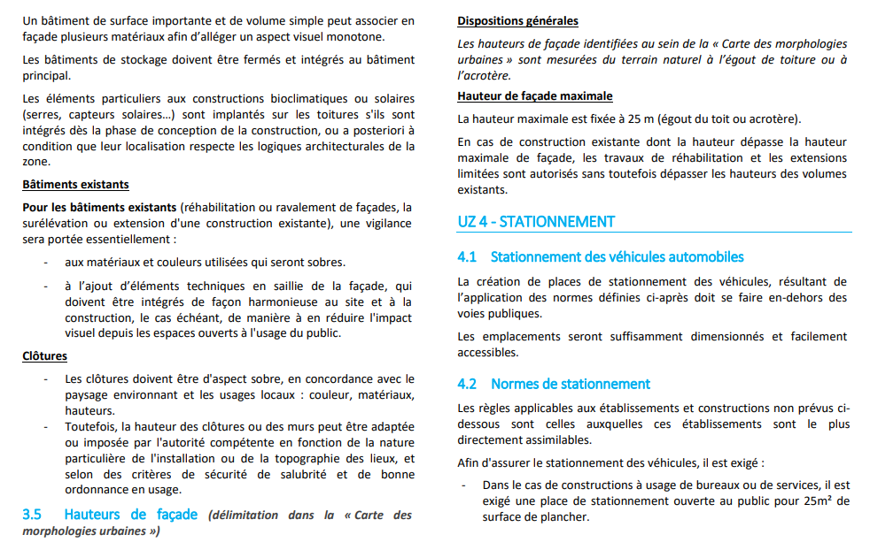
PLU analysis
Comments: UZ area
Footprint: No specific floor area Height: max 25m

Slide 15
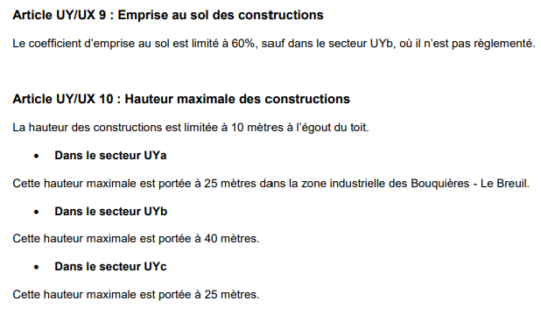
PLU analysis
Comments: UYb area
Footprint: unregulated Height: max 40m

Slide 16
Macro Sizing

Slide 17
PLU analysis
Comments
Landplot: c. 35 ha land area DC Building : 210 000sqm 1 level building 7m with 5m technical roof Data Hall : 105 000 sqm IT Load :250 MW PUE : 1,4 Total Power : 350 MW
RTE
RTE
UZ
DC 1
DC 2
UYb
DC 3

